Slide 1
UNIT 8 (CONT.)
THE STORY OF MY VILLAGE
E. LANGUAGE FOCUS

Slide 2
VOCABULARY
1. cow (n) : con bò cái
2. couch (n) : ghế trường kỷ
3. bone (n) : xương
4. slippery (a) : trơn
→ slip (v,n) : trượt, tuột/ sự trượt chân
5. announce (v) : thông báo, loan báo
announcement (n) : thông báo, cáo thị

Slide 3
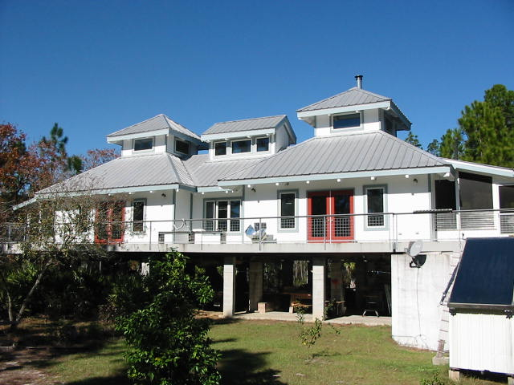
PRONUNCIATION
/aʊ/
/əʊ/
House
Coat

Slide 5
GRAMMAR
I am a student.
“ I am a student,” he said.
→ He said he was a student.

Slide 6
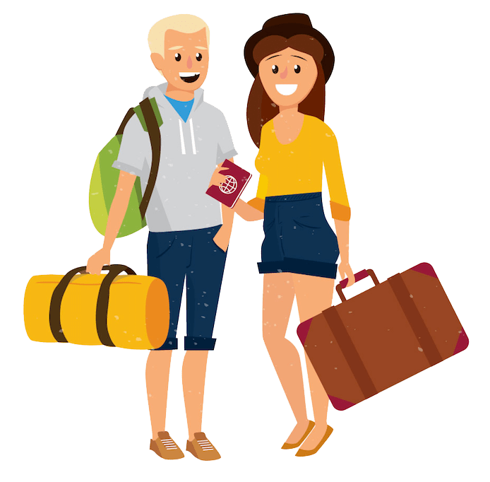
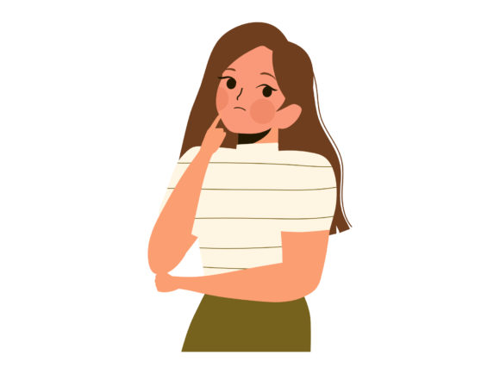
“ They will come here tomorrow,” she said.
→ She said that they would come there the day after.

Slide 7
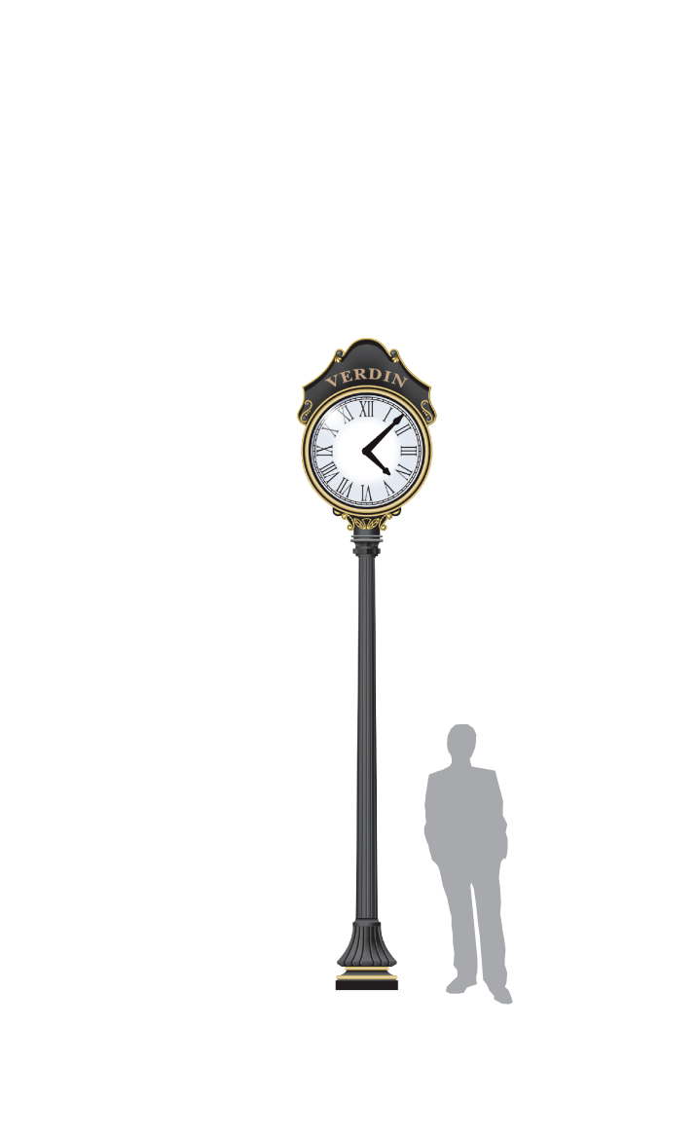
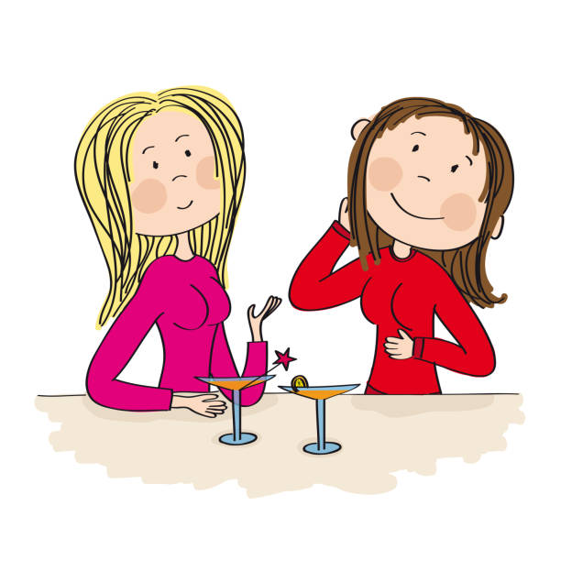
“ I don’t like going out at night,” she says to me.
→ She tells me that she doesn’t like going out at night.

Slide 8
* What are the rules in reported statements?
I. Reported speech: Statements
Rules:
a. Reporting verbs: say, tell + O
b. Verb changes:
* If the reporting verb is in the present tense, there is no tense change.
* If the reporting verb is in past tense, the verb in the reported clause moves “one tense back”.

Slide 9
Direct Speech | Reported Speech
1. Present Simple: V1 2. Present Progressive: am/is/are + Ving 3. Present Perfect: has/have + V3/ed 4. Past Simple: V2/ed 5. Past Progressive: was/were + V-ing 6. Past Perfect: had + V3/ed 7. Future Simple: will + Vo 8. can 9. may 10. must | 1. Past Simple: V2/ed 2. Past Progressive: was/were + Ving 3. Past Perfect: had + V3/ed 4. Past Perfect: had + V3/ed 5. Past Perfect progressive: had + been + V-ing 6. Past Perfect: had + V3/ed 7. would + Vo 8. could 9. might 10. had to

Slide 10
c. Pronoun changes:
Direct speech Reported speech
1st (I/ We ) → S
2nd ( you) → O
3rd → giữ nguyên

Slide 11
e. Time and place changes
Direct speech | Reported speech
today/ tonight | that day/that night
yesterday | the day before/the previous day
last month/ night … | the month before/the previous month/night
tomorrow | the following day/the next day/the day after
this month | that month
the day before yesterday | two days before
the day after tomorrow | two day after/in two days’time
next month | the month after/the following month
here | there
now | then
ago | before
this | that
these | those

Slide 12
Exercise 1. Report these statements, using the verbs suggested.
1. “Our lives have changed a lot thanks to the knowledge our children brought home.”
An old farmer said ________________________________________.
2. “I’m going to Ho Chi Minh City soon.”
She said ________________________________________________.
3. “The film will be interesting.”
I thought _______________________________________________.
4. “I can’t help you because I have too much to do.”
She said ________________________________________________.
their lives had changed a lot thanks to the knowledge their children had brought home
she was going to Ho Chi Minh City soon
the film would be interesting
she couldn’t help me because she had too much to do

Slide 13
Exercise 1. Report these statements, using the verbs suggested.
5. “Anne has written Jim a letter.”
Rick told me ____________________________________________.
6. “It took me three hours to get here because the roads were muddy and slippery.”
He told me ______________________________________________.
7. “I think it’s a crazy idea. It won’t work.”
She said ________________________________________________.
8. “Breakfast is served between 7:00 and 9:00.”
He announced ___________________________________________.
Anne had written Jim a letter
it had taken him three hours to get there because the roads had been muddy and slippery
she thought it was a crazy idea and that it wouldn’t work
breakfast was served between 7:00 and 9:00

Slide 14
Exercise 2. Complete the sentences, using the correct form of say, tell, and talk.
o
1. Jack ________ me that he was enjoying his new class.
2. Tom ________ it was a nice restaurant, but I didn’t like it very much.
3. The doctor _________ that I would have to rest for at least one week.
4. My aunt __________ us that she wouldn’t be able to come the next weekend.
5. At the meeting the teacher _________ about the problems our school had.
told
said
clause
said
told
o
talked

Slide 15
If I have money, I will buy a car.
have
will buy

Slide 16
II. Conditional sentence type 1:
a. Form:
If clause: simple present tense ( V_{1(s/es})
Main clause: will/ can + bare- infinitive
imperative or request
Ex: If I have enough money, I will go to Hue.
If he comes today, phone me at once.
b. Use: refer to a possible condition and a possible result at present or in the future.
c. Note: the difference between if and when:
When – clause refers to all time, not just the present or future.
Ex: When winter comes, it will be cold.
If I have free time tomorrow, I will visit you.

Slide 17
Exercise 3. Make sentences, using If……..,will…
If I do more homework, I’ll pass the exam.

Slide 18
If I pass the exam, I’ll go to medical college.

Slide 19
If I go to medical college, I’ll become a doctor.

Slide 20
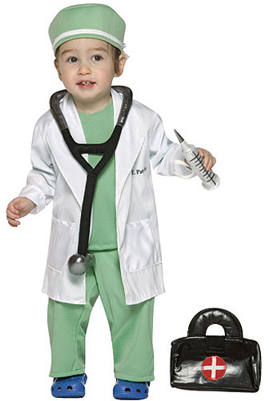
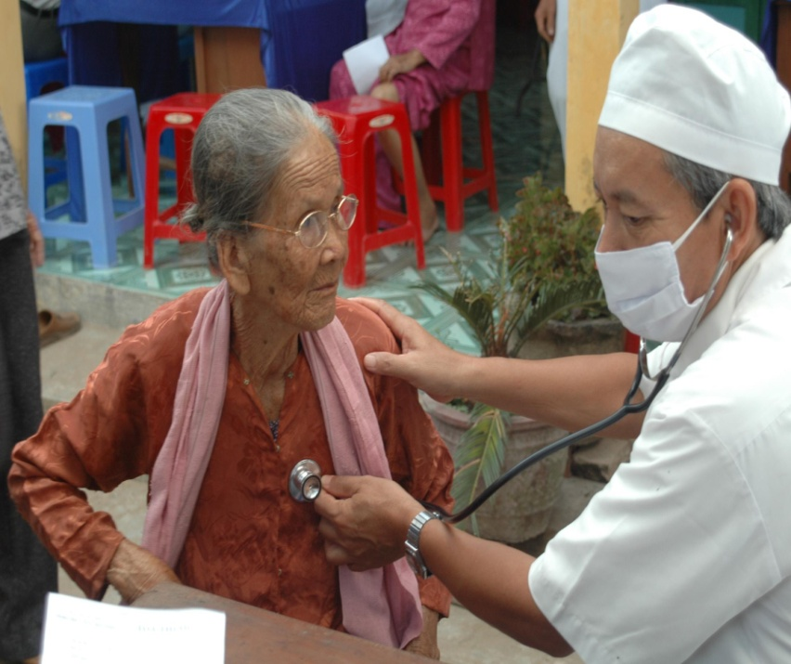
If I become a doctor, I’ll cure diseases and help sick people.

Slide 21
Exercise 4. Put when or if into each gap.
_____ there is a good programme on TV tonight, I’ll watch
______ I go home tonight, I’ll have a bath.
My family will go to the beach for our holiday ______we have enough money.
______ it’s a nice day tomorrow, we’ll go swimming
I’ll lend you my book _______ I finish reading it.
If
When
If
If
when

Slide 22
THANK YOU

